Slide 1
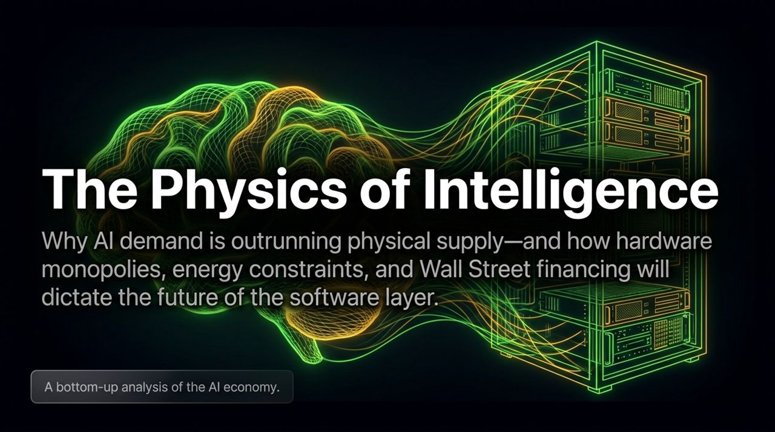
Notes:
Welcome everyone. Today, we are taking a bottom-up, fundamental look at the AI economy.
While software captures headlines and media narratives, software is bounded by physical reality. Intelligence isn't magic—it requires raw energy, silicon, physical infrastructure, and capital deployment.
The central thesis of this presentation is that AI demand is outrunning physical supply. Hardware monopolies, energy constraints, and Wall Street debt structures will ultimately dictate the future of the entire software layer.
https://www.youtube.com/watch?v=FGC4ofTcg2k

Slide 2
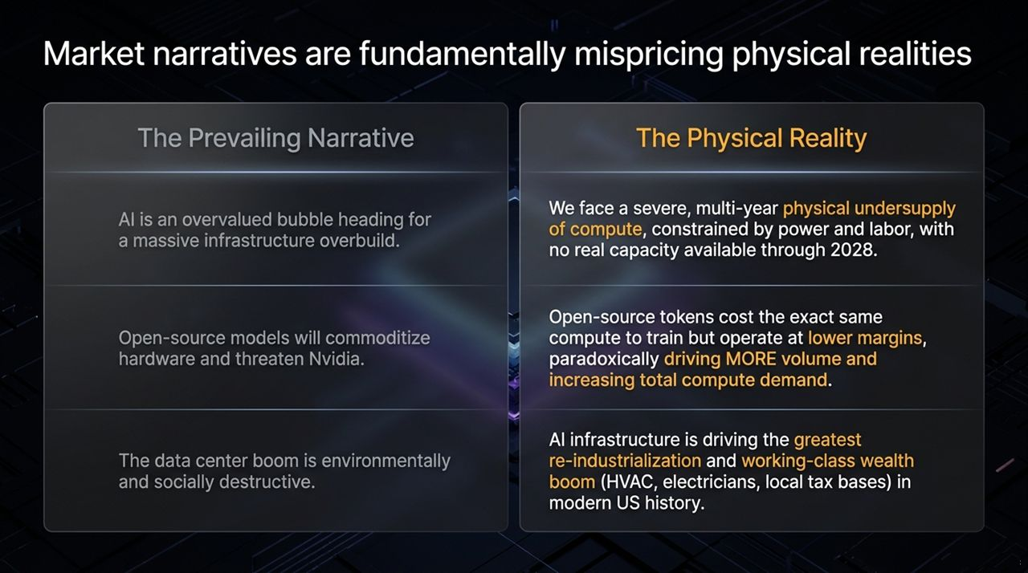
Notes:
Narrative vs. Reality Breakdown:
The Infrastructure Overbuild Narrative:
The Narrative: Mainstream media and public markets believe AI is a massive bubble heading toward an overbuild of data centers.
The Reality: Gavin Baker highlights that there is no available compute capacity through 2028. We face a multi-year physical undersupply constrained by power grids, transformer leads, and skilled trade labor.
The Open-Source Threat to Hardware:
The Narrative: Open-source models (like DeepSeek or Llama) will commoditize intelligence, lower software prices, and hurt hardware giants like Nvidia.
The Reality: An open-source token requires the exact same physical compute to train and run as a closed frontier token. Lower software margins drive exponential mass consumption, increasing overall compute volume and boosting Nvidia’s business.
Social and Environmental Impact:
The Narrative: Data centers are destructive environmental drains on local communities.
The Reality: Data center construction is driving the greatest re-industrialization and working-class wealth boom in modern US history, revitalizing local tax bases and creating high-paying jobs for trade workers.

Slide 3
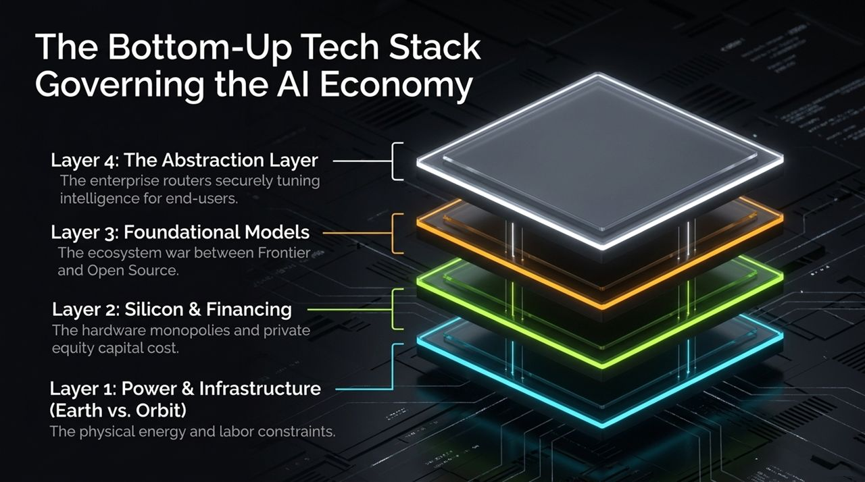
Notes:
Overview of the Stack:
To understand how value accrues across the AI economy, we must evaluate the technology stack from the ground up, starting with physics and ending with end-user applications.
Layer Breakdown:
Layer 1: Power & Infrastructure (Earth vs. Orbit): The foundation of all intelligence is physical energy (natural gas, nuclear, solar) and real-world labor (electricians, HVAC). As terrestrial limits hit walls, orbital compute becomes an economic alternative.
Layer 2: Silicon & Financing: Hardware monopolies (Nvidia’s 9-chip ecosystem) coupled with private equity capital structures (Blackstone, Apollo, KKR) dictate who can build clusters at scale.
Layer 3: Foundational Models: The ongoing war between closed Frontier Labs (OpenAI, Anthropic) and Open-Source ecosystems (Meta, DeepSeek).
Layer 4: The Abstraction Layer: Enterprise middleware and routers that securely tune models to proprietary data without leaking IP.
Key Point:
Value flows upward, but control remains rooted in Layers 1 and 2.

Slide 4
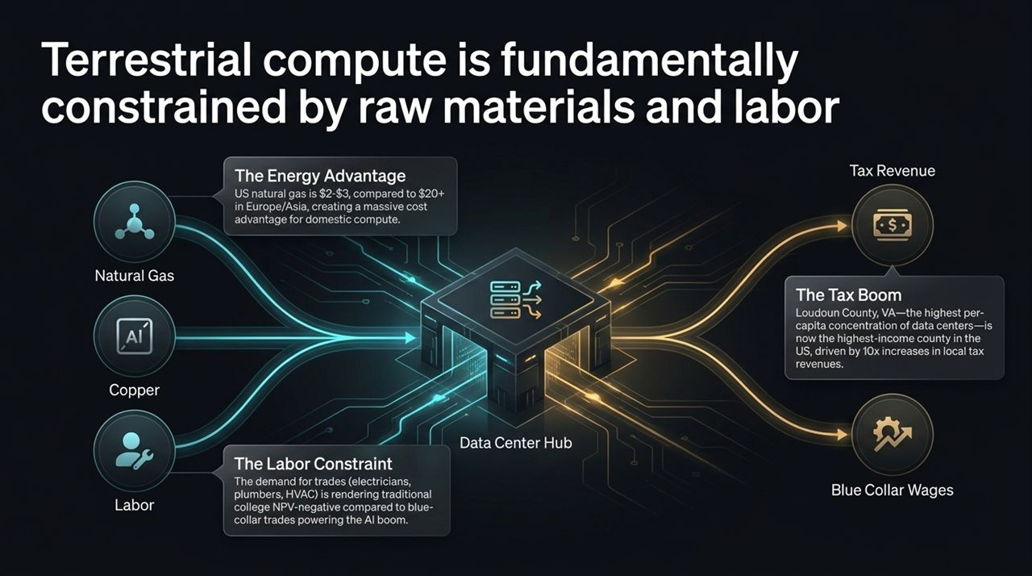
Notes:
The Energy Advantage:
US natural gas trades around $2–$3, compared to $20+ in Europe and Asia. This creates an unbeatable structural energy cost advantage for US-based compute.
The Labor & Trade Shift:
Four-year college degrees are facing negative Net Present Value (NPV) compared to skilled blue-collar trades. Electricians, plumbers, and HVAC technicians needed to build data centers are making record wages.
The Local Tax Boom:
Data centers revitalize small, rural American towns.
Loudoun County, VA Case Study: Loudoun County has the highest concentration of data centers per capita and is now the highest-income county in the US. Data centers have increased local tax revenues by up to 10x, funding schools, infrastructure, and public services.

Slide 5
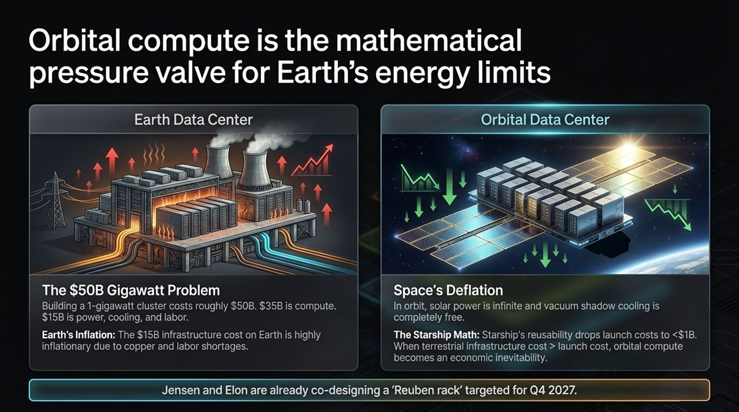
Notes:
The Terrestrial Gigawatt Problem:
Building a 1-gigawatt cluster on Earth costs ~$50 Billion.
~$35 Billion goes to IT/compute hardware, while ~$15 Billion goes to power generation, cooling, land, and construction labor.
Earth’s $15B infrastructure portion is heavily inflationary due to rising labor costs and shortages of materials like copper.
The Space Deflation Mechanics:
Space eliminates the $15B terrestrial burden. Solar power in orbit is continuous, and vacuum radiator cooling (placing radiators in shadow) is free.
The Starship Math: Starship’s full reusability drops total launch costs to under $1 Billion per gigawatt equivalent.
When terrestrial infrastructure costs ($15B+) exceed orbital launch costs (<$1B), moving compute off-world becomes an economic certainty.
Real-World Timeline:
Elon Musk and Jensen Huang have already co-designed a space-optimized Reuben rack targeting launch readiness by Q4 2027/2028.

Slide 6
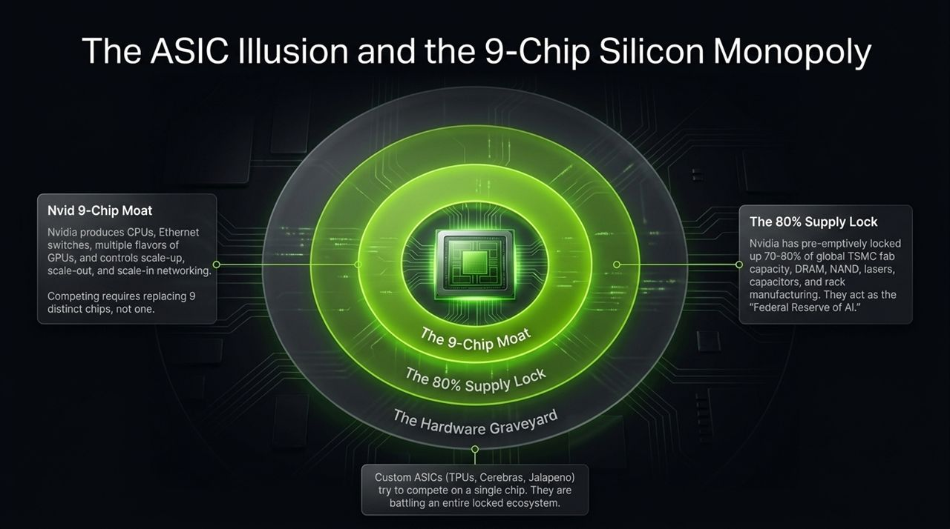
Notes:
The Myth of ASIC Competitors:
Wall Street often assumes custom ASICs (Google TPUs, Cerebras, Jalapeno) will displace Nvidia.
The 9-Chip Moat:
Nvidia does not just sell a GPU; they manufacture an integrated system across 9 distinct chip types. This includes CPUs, Ethernet switches, multiple GPU variants, and scale-up/scale-out/scale-in networking fabrics.
To displace Nvidia, a competitor cannot just build a faster accelerator chip; they must replace an entire 9-chip hardware-software stack.
The 80% Supply Lock:
Nvidia functions as the "Federal Reserve of AI". They have pre-emptively locked up 70–80% of global TSMC wafer capacity, high-bandwidth memory (DRAM), NAND storage, lasers, capacitors, and specialized rack manufacturing.

Slide 7
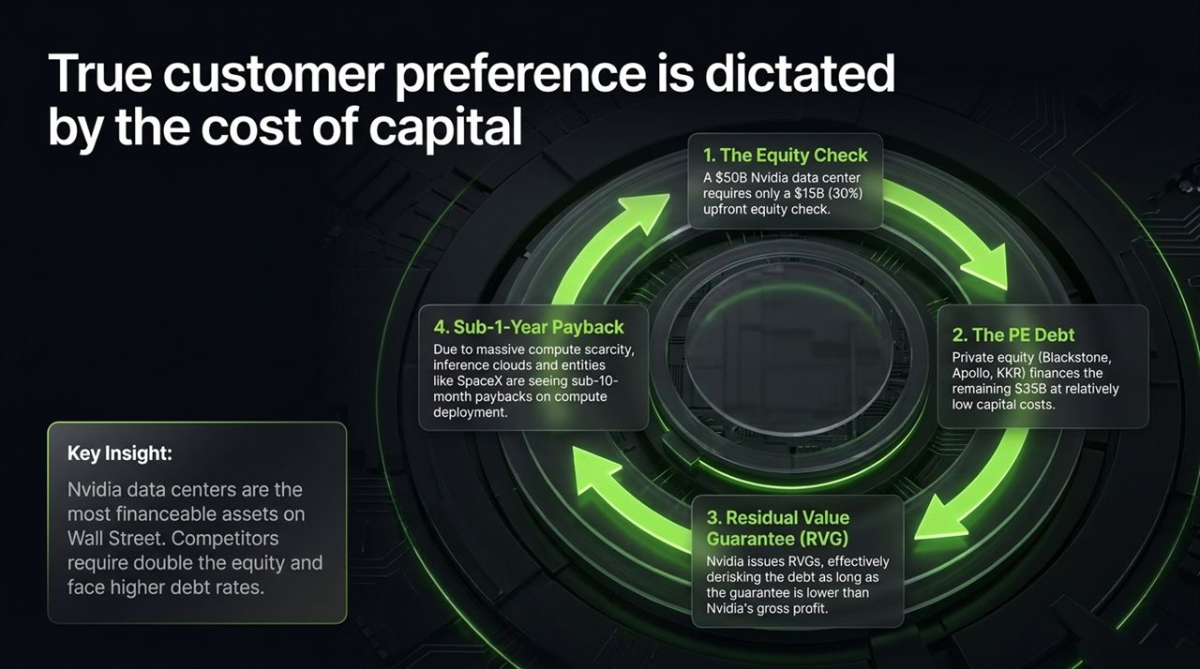
Notes:
Why Capital Structure Wins Hardware Wars:
Benchmark performance matters, but cost of capital dictates scale deployment.
The Four Financial Pillars of Nvidia's Dominance:
Low Equity Requirements: A $50B Nvidia data center requires only a ~$15B (30%) upfront equity check from the operator.
Private Equity Financing: Top PE firms (Blackstone, Apollo, KKR) comfortably finance the remaining $35B in low-cost debt.
Residual Value Guarantees (RVG): Nvidia issues RVGs on its hardware, derisking PE debt as long as the guaranteed value stays below Nvidia’s overall gross profits.
Sub-1-Year Payback: Scarcity allows NeoClouds (Nebius, CoreWeave) and operators to monetize compute rapidly, generating sub-10-month financial paybacks.

Slide 8
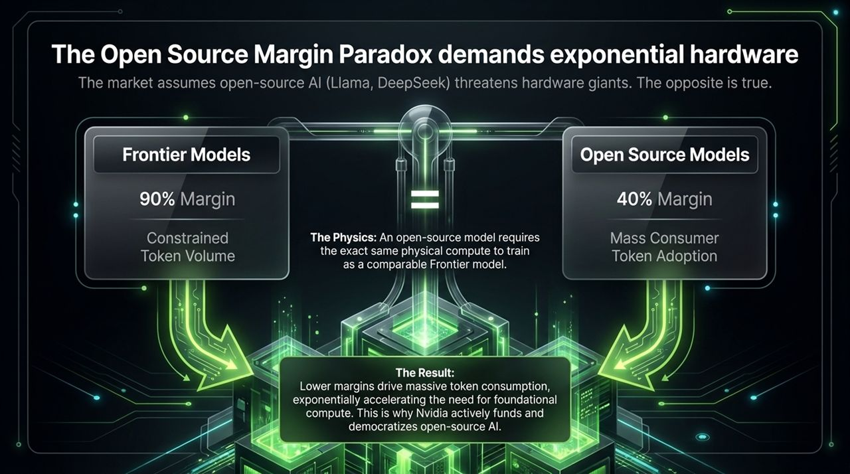
Notes:
The Misconception:
Bearish analysts argue open-source AI (Llama, DeepSeek) will kill hardware margins and destroy demand.
The Margin Paradox Dynamics:
Frontier Models: Closed labs operate at high software gross margins (~90%), keeping token pricing higher and constraining overall consumer volume.
Open-Source Models: Open-source ecosystems operate at lower software gross margins (~40%). Lower token prices unleash massive enterprise and developer volume.
Hardware Impact:
Training an open-source model takes the exact same compute as a frontier model.
Exponential token adoption driven by open source accelerates total hardware demand. This is why Nvidia actively funds and nurtures open-source development.

Slide 9
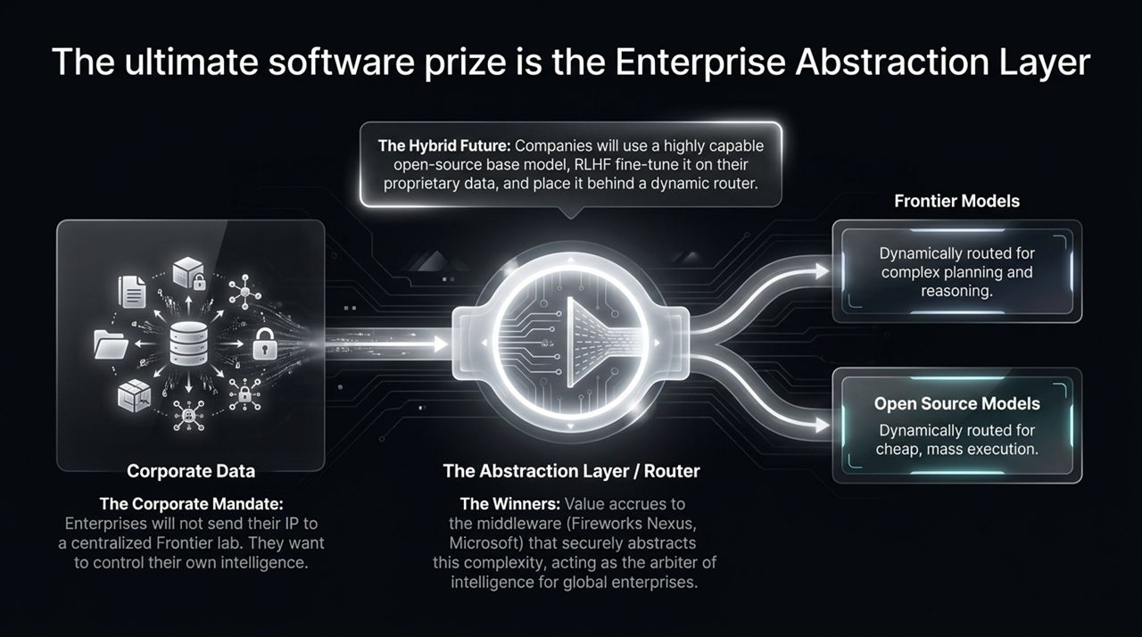
Notes:
The Enterprise Mandate:
Global corporations will not send sensitive IP or customer data to centralized third-party frontier model labs. Enterprises insist on owning and controlling their own intelligence.
The Hybrid Future Architecture:
Enterprises take a base open-source model, fine-tune it with proprietary company data, and host it locally or in private clouds.
Queries pass through a Dynamic Abstraction Layer / Router:
Simple, high-volume, low-cost tasks route to internal fine-tuned open-source models.
Complex reasoning or multi-step planning routes dynamically to Frontier models.
Value Accrual:
Middleware and routing providers (Fireworks Nexus, Microsoft, DataBricks) capture high-margin software value by serving as arbiters of enterprise intelligence.

Slide 10
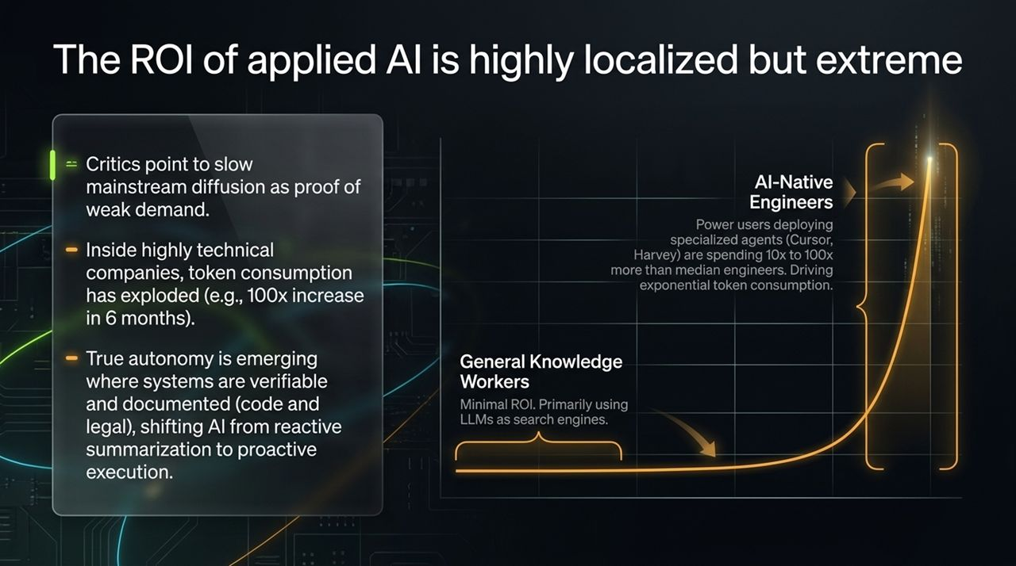
Notes:
Diffusion Curve Realities:
Critics claim AI is a bubble because knowledge workers still use LLMs mostly for basic search or summarization.
However, inside AI-native and highly technical organizations, token consumption is exploding.
The Power-User Shift:
Power engineers using tools like Cursor, Harvey, or specialized agents consume 10x to 100x more tokens than median engineers.
Internal data from hedge funds and tech firms shows 100x increases in token consumption over 6-month spans.
Proactive Execution vs. Reactive Summarization:
Shift occurs when environments are verifiable and documented (codebases, legal contracts), moving AI from reactive summarization to proactive execution.

Slide 11
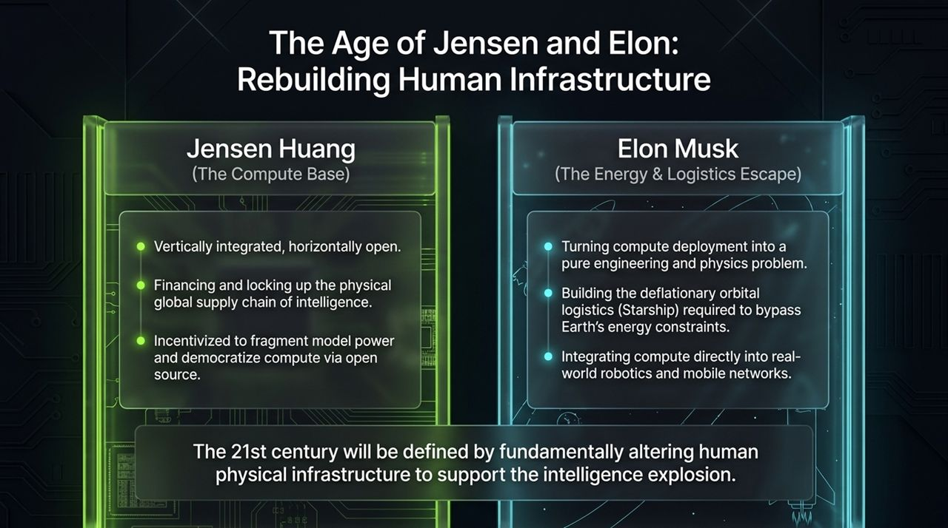
Notes:
Two Pillars of 21st-Century Infrastructure:
Jensen Huang (Compute Base):
Vertically integrated hardware, horizontally open ecosystem.
Standardizes capital financing and secures global physical supply chains.
Uses open-source enablement to fragment model power, preventing closed-lab monopolies.
Elon Musk (Energy & Orbital Escape):
Treats compute deployment as an integrated engineering and physics problem.
Building Starship as a deflationary orbital logistics system to bypass Earth's energy and infrastructure limits.
Connects real-world robotics (Optimus) and global satellite networks (Starlink) directly to compute power.

Slide 12
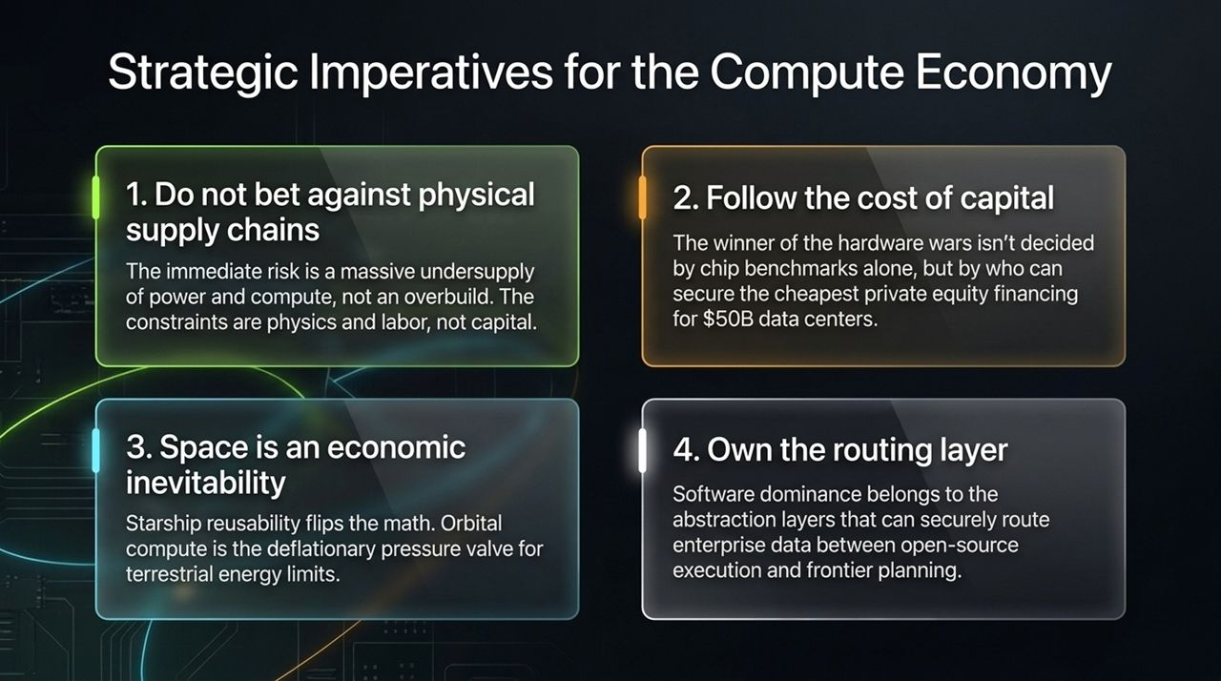
Notes:
Key Takeaways for Investors and Operators:
Do Not Bet Against Physical Supply Chains: The near-term bottleneck is an acute undersupply of power, compute, and trade labor, not an overbuild.
Follow the Cost of Capital: Silicon efficiency matters, but lower capital costs via private equity debt and residual value guarantees determine deployment scale.
Space is an Economic Inevitability: Starship reusability flips orbital compute economics, creating a deflationary valve for terrestrial energy constraints.
Own the Routing Layer: Long-term enterprise software profits belong to abstraction layers that seamlessly route data between open-source execution and frontier model planning.

Slide 13
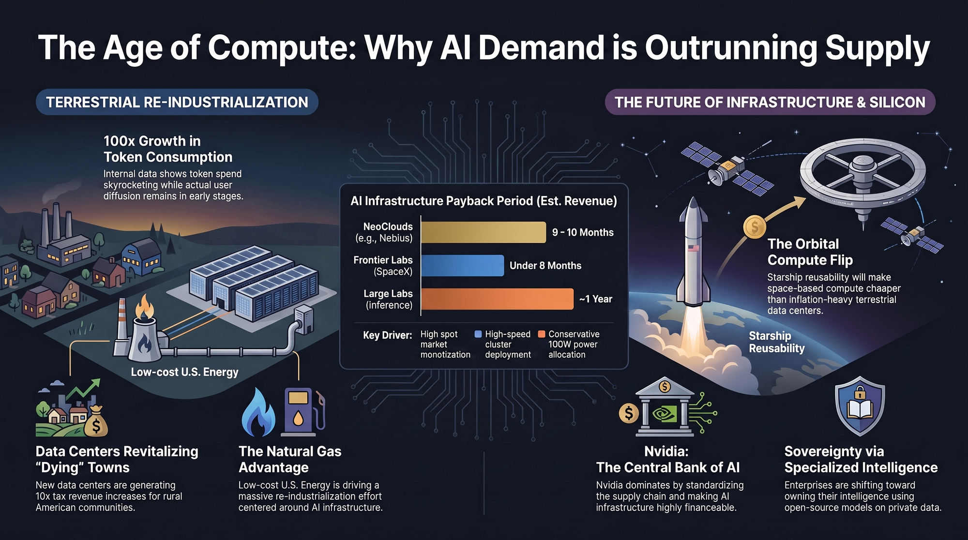
Notes:
Summary Overview:
Demand Drivers: 100x internal token growth, fast paybacks across NeoClouds (9–10 months), and specialized enterprise routing.
Terrestrial Re-Industrialization: Low-cost US natural gas ($2–$3) provides a core industrial advantage, while data centers generate 10x tax revenue boosts for rural communities.
Future Scale: Nvidia anchors terrestrial finance, while Starship unlocks orbital compute to bypass terrestrial energy limits.

